Slide 1

DSCI 5340 Final Project Using ARIMA Model
Team Members: Oluwaseyitan Awojobi Giorgio Saez Mike Pratt Tomisin Oloniyo

Slide 2
Introduction
In running this analysis, we forecast the sales of homes for the years 2015 to 2017. With a dataset of 200 from 1965 to 2014. Using the quarterly sales, the home sales is used as the dependent variable while the home vacancy rate and homeownership rate are used as the predictor variable. This analysis was done using SPSS and Minitab.

Slide 3
ARIMA Model Used:
Model Description
 |  |  | Model Type
Model ID | Home Sales (1'000s) | Model_1 | ARIMA(5,1,1)(0,1,1)

Slide 4
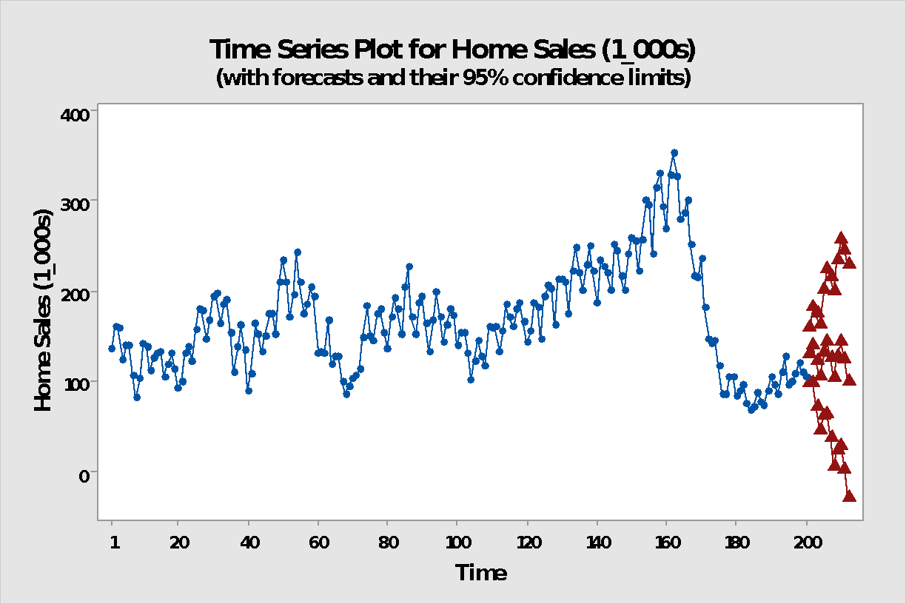
Time Series Plot
Minitab

Slide 5
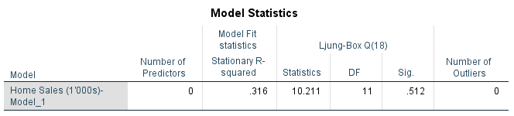
Ljung Box

Slide 6
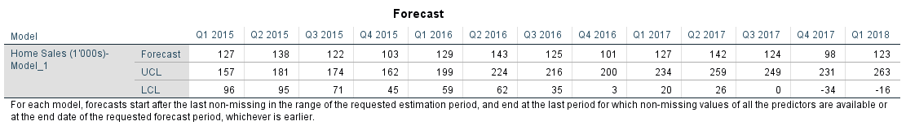
Forecast

Slide 7
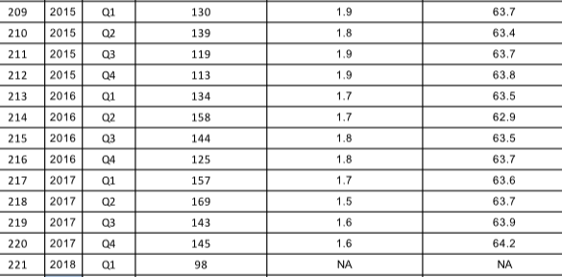
Actuals

Slide 8
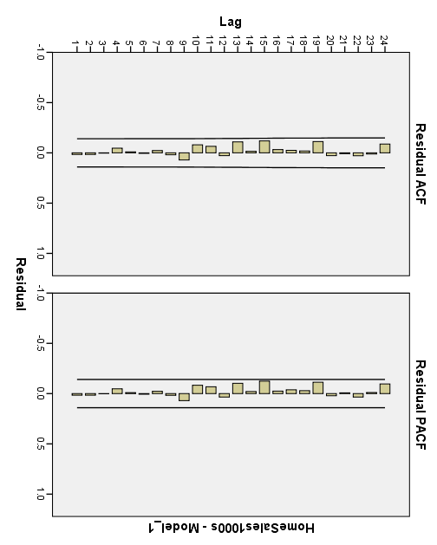
Autocorrelation and Partial ACF

Slide 9
Description of Analysis
ARIMA: The model used in forecasting result: Autoregression:5, Differencing: 1, Moving Average: 1
The time series plot shows that the data is non-stationary
A high P-Value is evident in the Ljung box test which shows that the result is significant. The higher the p-value, the better.
The forecasted home sales value is closely related to the actual values. The actual values also fall in between the upper limit and lower limit interval.

Slide 10
Analysis of ACF and PACF Plot
Both ACF and PACF Plots show that the model is a good fit as there is no lag protruding out of the lag residuals threshold.

